Slide 1
Defining ourselves: Data Analysis at Nonprofits
TNB Roundtable June 2016

Slide 2
Who we are:
Annie Fletcher, St. Francis House
Blessing Dube, Institute for Community Health
Shane Culliton, Codman Square Neighborhood Development Corporation
Gavin O'Brien, Community Servings
Matan BenYishay, Pine Street Inn

Slide 3
What is data?
Information
Structure
Data

Slide 4
I don’t use data! Do I?
Basic tracking
Unstructured operations information
Data structured and prepped for insights
Complex reports (funder or internal learning)

Slide 5
Basic tracking
Insight: We know who comes to our sessions!

Slide 6
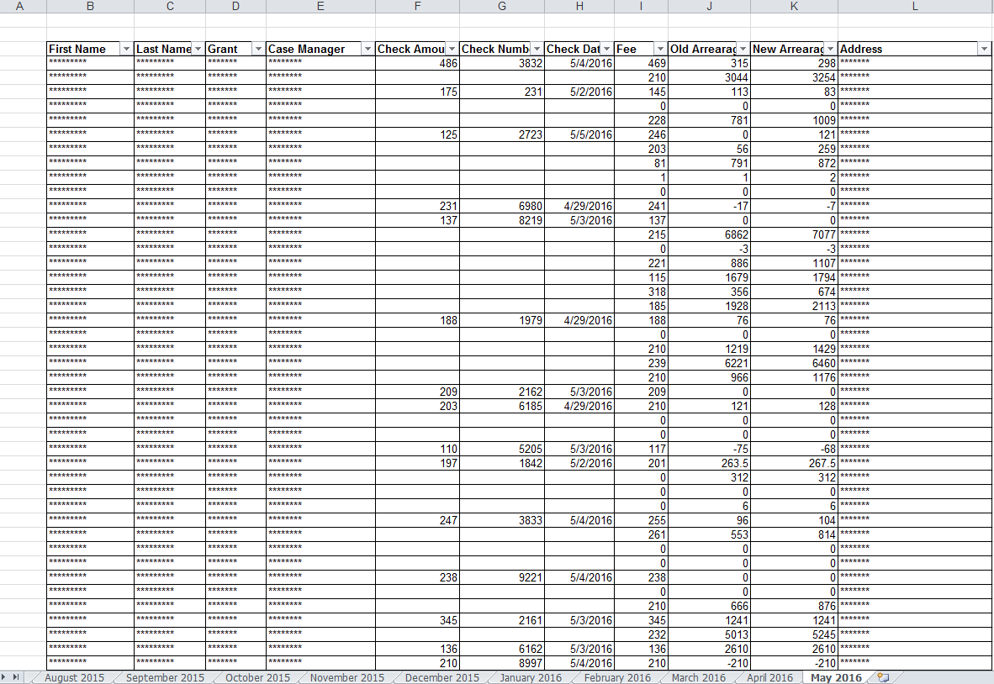
Unstructured info
Each month has its own tab
Insight: We have so much information!

Slide 7
Data prepped for insights
2-month gaps
Insight: client pays inconsistently/on own schedule!

Slide 8
Complex reports
Q18: Physical and Mental Health Condition at Entry
Program Applicability: All SHP, SH, S+C, SRO, HPRP
Client Applicability: All Persons
Physical and mental health conditions and number of health conditions | Total number of persons |  | Number of persons in households without children |  | Number of persons in households with children |  |  |  | Number of Persons in Unknown Households
 |  |  |  |  | Persons in households with at least one adult and one child |  | Persons in households with only children
 | N | % | N | % | N | % | N | % | N | %
(18a1) Known Physical and mental health conditions
Mental illness | 11 | 64.7% | 11 | 64.7% | 0 |  | 0 |  | 0
Alcohol abuse | 8 | 47.1% | 8 | 47.1% | 0 |  | 0 |  | 0
Drug abuse | 6 | 35.3% | 6 | 35.3% | 0 |  | 0 |  | 0
Chronic health condition | 8 | 47.1% | 8 | 47.1% | 0 |  | 0 |  | 0
HIV/AIDS and related diseases | 0 | 0.0% | 0 | 0.0% | 0 |  | 0 |  | 0
Developmental disability | 0 | 0.0% | 0 | 0.0% | 0 |  | 0 |  | 0
Physical disability | 8 | 47.1% | 8 | 47.1% | 0 |  | 0 |  | 0
Very big!
Very small!
Insight: Some things are low and some are high! Also:

Slide 9
What data offers…
Staff/Management
External
Funders
Internal
Leadership
Public
Field

Slide 10
Management/staff
Data offers…
Perspective!
I know what my job is!
But there’s an island over here!

Slide 11
Leadership
Data offers…
Improvement
Why are the outcomes so bad?
Can’t tell you – we don’t track outputs!
Data diva/dude
The
Boss
Can you make them better?
!$@#&!

Slide 12
Funders…
Data offers…

Slide 13
The public and the field…
Data offers…

Slide 14
What we do: data cycle
Design knowledge management systems and frameworks
Training
Data quality
Analyze & report!
Insights & feedback

